Slide 1
The Phoenix Force
The Student Recreation Center
Tierra Binford, Jade Brown, Keith Camp, Noah Smith, Elise Timmons, Levi Walton

Slide 2
Key Points
Gantt Chart
Use Cases
Use Case Diagrams
Prototypes

Slide 3
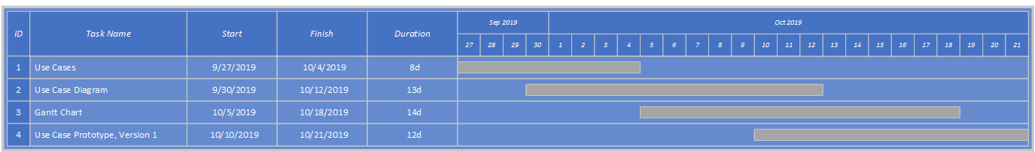
Gantt Chart

Slide 4
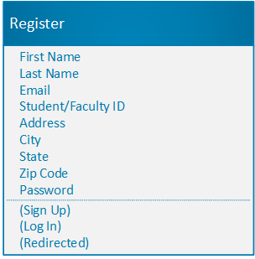
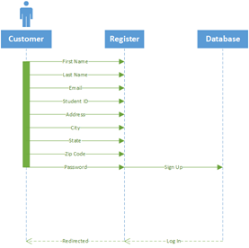
Use Cases
Register
Risk Level: High
Primary Actor: Customer
Preconditions: Customer account does not exist
Postconditions: Customer account is created
Main Flow:
Visitor goes to the SRC website
Visitor clicks on “Register”
Visitor is redirected to the create profile page
Visitor enters first name in the first name text box
Visitor enters last name in the last name text box
Visitor enters email in the email text box
Visitor enters student or faculty ID if applicable
Visitor enters address in the address text box
Visitor enters city in the city text box
Visitor selects state from the state combo box
Visitor enters zip in the zip code text box
Visitor enters password in the password text box
Visitor enters password in the re-enter password text box
Visitor clicks “Register” button at the bottom of the page
Visitor is directed to their account page
Visitor is added to the database
Visitor receives confirmation email
Use case ends

Slide 5
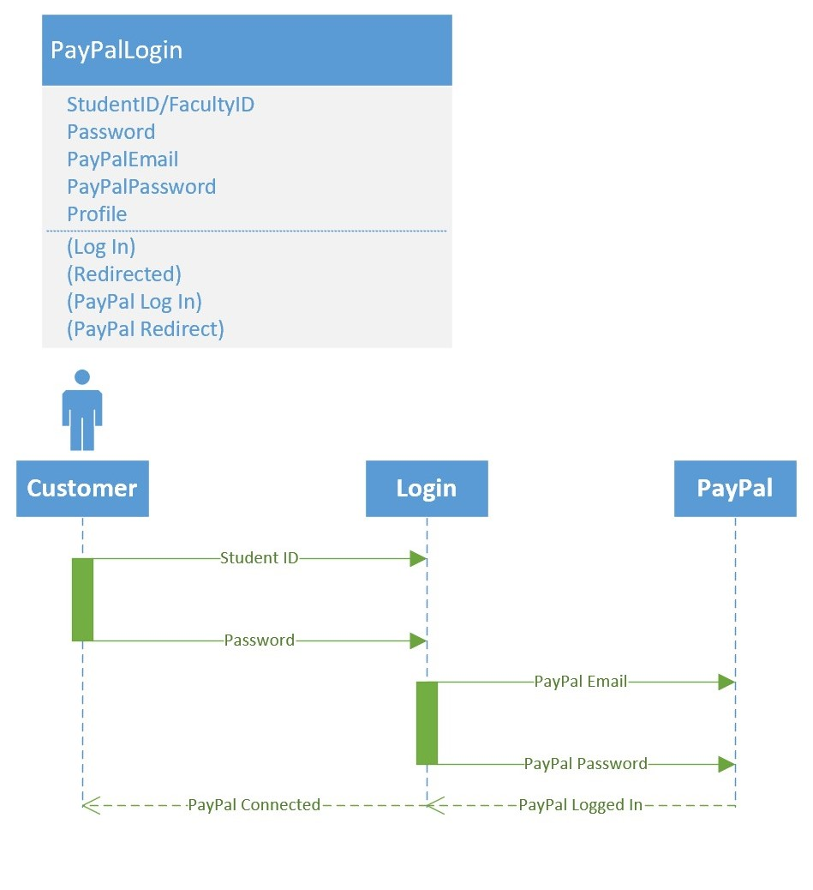
Setup PayPal Information
Risk Level: High
Primary Actor: Customer
Preconditions: Customer has an account. Customer has PayPal Account
Postconditions: Customer sets up their payment information
Main Flow:
Visitor goes to the SRC website
Visitor clicks on “Log Into Account”
Visitor is redirected to their profile
Visitor navigates to the PayPal information section
Visitor clicks on “Edit PayPal information”
Visitor input their PayPal email
Visitor inputs their PayPal password
Visitor clicks on “Save changes”
Visitor information is updated
Use case ends

Slide 6
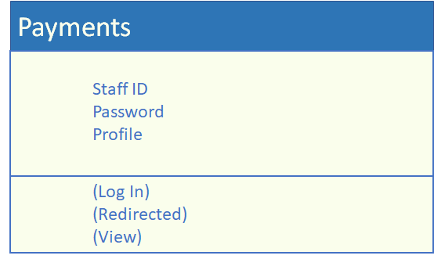
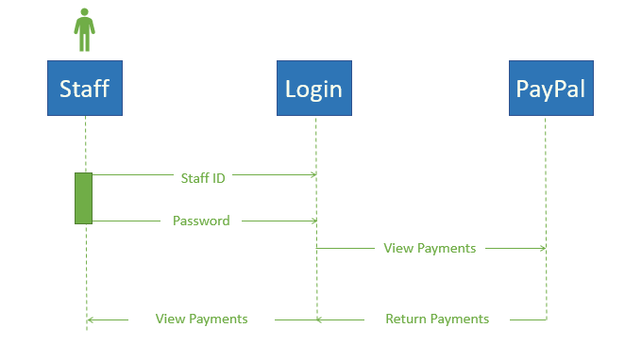
View customer payments
Risk Level: High
Primary Actor: Staff
Preconditions: Staff must have an account
Postconditions: Staff has viewed payments
Main Flow:
Staff goes to the SRC website
Staff clicks on “Log Into Account”
Staff is redirected to their profile
Staff navigates to “Payment History”
Staf views the payment history
Use case ends

Slide 7
Update upcoming events
Risk Level: Low
Primary Actor: Staff
Preconditions: Staff must have admin access to Upcoming Events page
Postconditions: Staff updates Upcoming Events page
Main Flow:
Staff goes to the SRC website
Staff clicks on “Log Into Account”
Staff is redirected to their profile
Staff navigates to Upcoming Events page
Staff updates Upcoming Events page
Use case ends

Slide 8
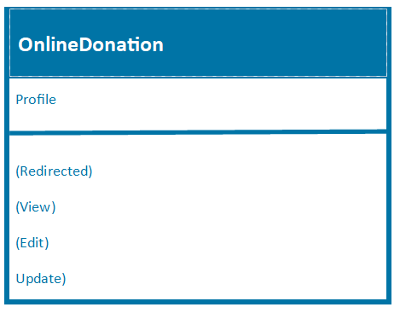
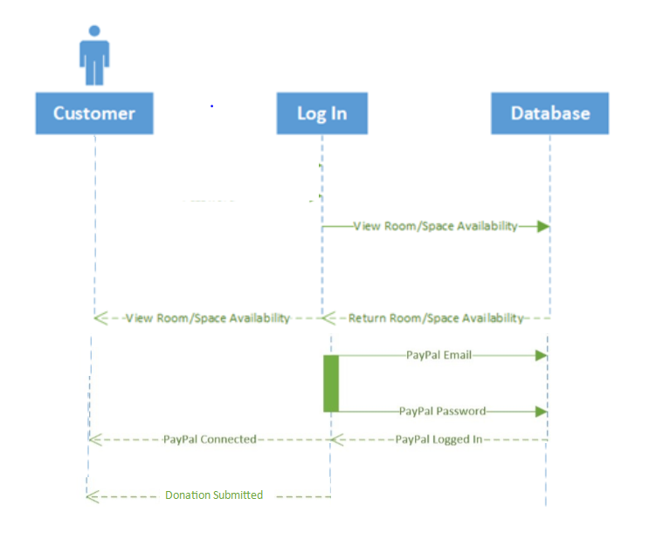
Make Online Donation
Risk Level: High
Primary Actor: Customer
Preconditions: Customer may or may not have an account. Must own form of payment besides cash or check.
Postconditions: Customer has made online donation.
Main Flow:
Visitor goes to SRC website
Visitor clicks on “Log Into Account”
Visitor is redirected to their profile
Visitor navigates to Donation Link
Visitor views Donation Information
Visitor clicks “Make a Donation”
Visitor fills out payment information through Paypal
Visitor is sent a confirmation (and thank you) email
Use case ends

Slide 9
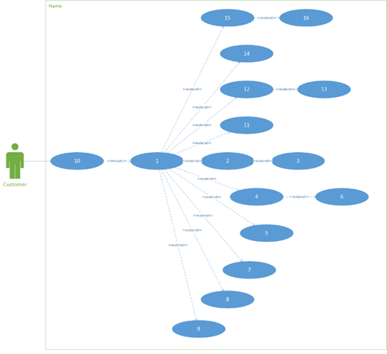
Customer Use Case Diagram

Slide 10
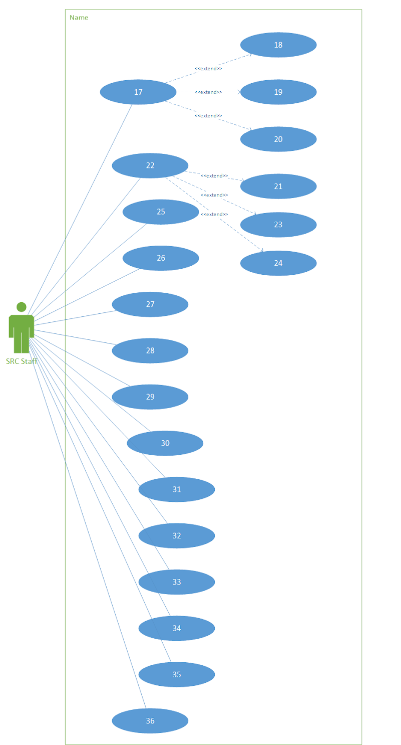
Staff Use Case Diagram

Slide 11
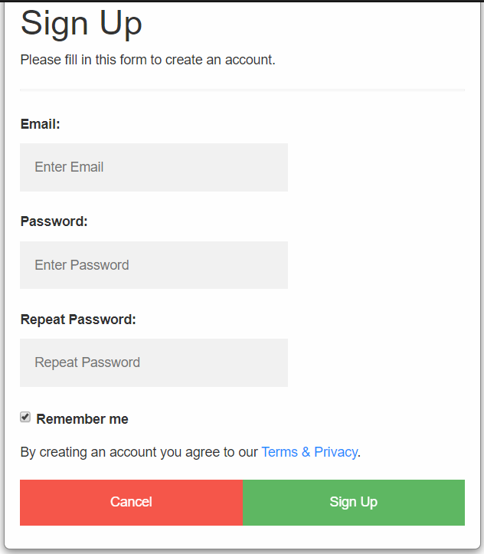
Register Prototype

Slide 12
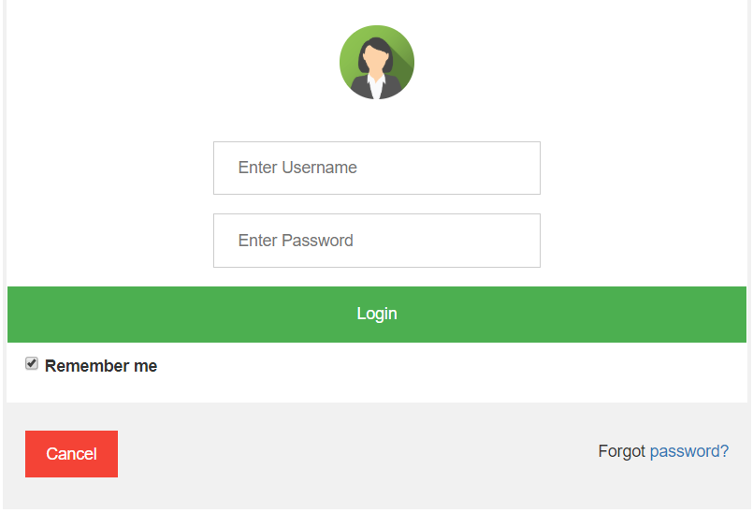
Log In Prototype

Slide 13
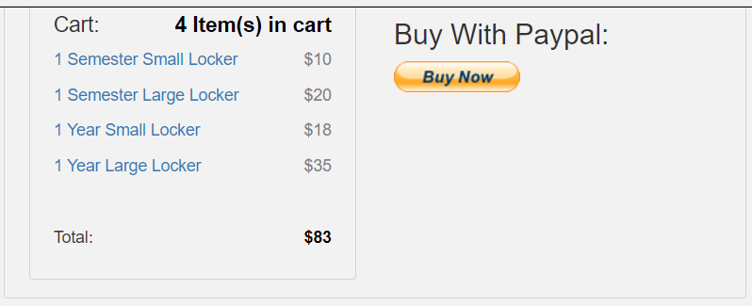
Payment Prototype

Slide 14
Any Questions?

